Slide 1
Online Learning from Variable Feature Streams
Ege Beyazit Xindong Wu

Slide 2
Recap
Online Learning
Training data is too large to fit in the memory or complete data is not initially available
Learn from data incrementally, update your estimates as each new data arrives.
Learning from Data Streams
Online and continuously growing data
Entire dataset can not be stored in memory, some data must be eventually forgotten
Characteristics of the data can change over time: Concept drift (dataset shift).
Must deal with missing, corrupted, noisy data in real time.
Notes:
I will start explaining some terminology first:
1- Traditional machine learning algorithms work on complete data. Online learning is a paradigm that is useful where the training data is too large to fit in your memory or you just do not have the complete data initially. In this case, you receive the data instances incrementally and update your estimates as you see more instances.
2- Data streams pose some problems that prevent the use of standard data mining algorithms. In a learning from data stream scenario, dataset is online and continuously growing. So the algorithm must work on constant memory. Entire dataset can not be stored in memory, some data must be eventually forgotten. Additionally, characteristics of the dataset can change over time, so the algorithm must be able to adapt this change.

Slide 3
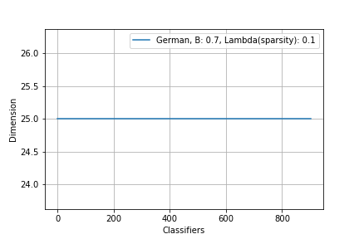
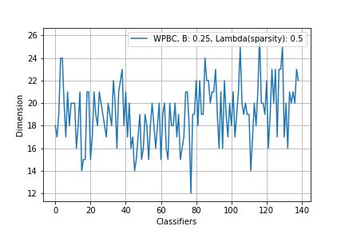
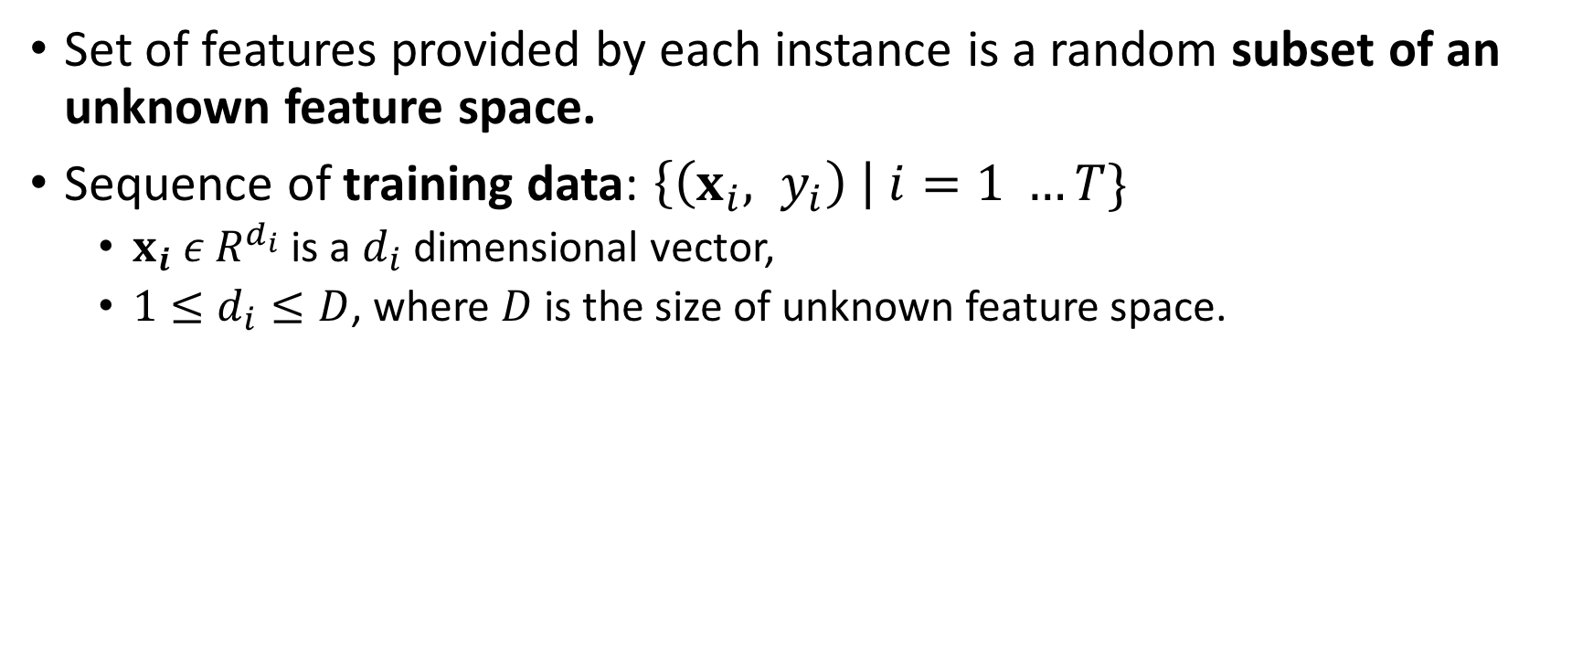
Variable Features - I
Set of features provided by each instance is a random subset of an unknown feature space.
Sequence of training data: $\left\{\left(x_{i}, y_{i}\right) \right| i=1 …T\}$
$x_{i} ε R^{d_{i}}$ is a $d_{i}$dimensional vector,
$1≤d_{i}≤D$, where $D$ is the size of unknown feature space.
Notes:
A dataset with variable features is a a set of training instances where features provided by each instance is an arbitrary subset of an unknown feature space.
So, with each training instance amount and type of data provided can change arbitrarily.
This means unlike other online learning setups, data is not being generated by following a specific structure.
In the figures, you can see plot of training example, and number of features provided with that example. You can picture number of features as number of columns of a dataset.
Left figure represents a traditional data stream, number of features provided by training examples does not change, or you can say with each row, 25 columns of data provided. However in figure 2, you can see a variable feature stream, number of features provided by training instances change over time, number and types of columns provided with each row can change.

Slide 4
Variable Features - II
What kind of data sources can generate variable features?
Data sources that can change characteristics over time,
Data sources that can be a combination of large number of distributions in different dimensions,
Data sources that are being observed in a noisy environment that prevents the observation of all features.
Data streams with variable features
If the complete dataset is initially known, variable features can be handled (by treating them as missing values) by several preprocessing techniques. *
Treating data streams with variable features as missing values is a crude assumption because:
Data is not actually missing, data source has changed its characteristics (if the data source does not provide the features that it used to provides, this is also an information)
Handling missing values in real time needs additional memory and time, and since full feature space is unknown it is not possible with existing methods.

Slide 5
Variable Features: Toy Example - I
Task: Spam e-mail classification, see words as features.
Date: August 2017
Words being used in spam e-mails:
Philanthropy, donation, charity, money
Date: September 2017
Event: Government enforces a new tax form to be filled in one month.
Result: Spammers started to send new tax form e-mails with a virus attached.
Words being used in spam e-mails:
Philanthropy, donation, charity, money, tax, form, fill, government, law
Date: October 2017
Event 1: Halloween
Event 2: Government tax form deadline.
Event 3: Your boss sent an e-mail to you related to companies tax works.
Result 1: Spammers started to send e-mails like this this: “Before Halloween night if you do not send this e-mail to 10 other people, you will be cursed by souls of the dead.”
Result 2: Spammers stopped sending e-mails related to tax form law. Likelihood of an e-mail being spam given that it includes keyword ’tax’ is decreased.
Words being used in spam e-mails:
Philanthropy, donation, charity, money, dead, souls, Halloween, curse
Space of features to identify a spam e-mail dynamically changes over time, according to events happening in the world.
Notes:
Imagine how big is this feature set and how fast it is changing, based on all the events happening in the world.
-> Here also discuss how will you classify an e-mail after spam e-mail space excludes those specific words, try to find a good example for this too, such that spam will become an important e-mail after some time.

Slide 6
Variable Features: Toy Example - II
Task: Disease diagnosis
Company C Health Services have 100 hospitals around the world: Small Hospitals and Large Hospitals,
Real time data is being collected from hospitals to train a disease diagnosis classifier,
Assume to diagnose the disease D, 10 different tests can be used,
By the time, some tests become outdated and some new tests are being invented,
Each doctor can use different set of tests to diagnose a disease based on:
Experience
Available technology (small vs. large hospital)
Condition of the patient
Exponential number of different set of tests can be made to diagnose a patient,
Everyday, 1000’s of doctors collect data from 10000’s of patients,
Diseases can mutate hence tests to diagnose a disease can change over time.
Notes:
Company C Health services have 100 hospitals all around the world. They have 2 types of hospitals:
1- Large hospitals which are fully equipped with newest technology.
2- Small hospitals which only have most fundamental devices.
Data analysis department of C Health services collect real time information from all of these hospitals to trains classifier for disease diagnosis.
-Assume that to diagnose disease D, 10 different types of tests can be used.
-By the time, some tests prove to be outdated some other tests have been invented.
-Each doctor can use different set of tests to diagnose a disease
1- Based on their experience
2- Based on available technology
3- Based on trends in medicine
4- Based on the current condition of patient (not prefer to do biopsy to a child because its too painful) + Likeliness of having a disease depends
-2^10 different set of experiments can be done (if number of tests stay constant)

Slide 7
Variable Features: Problem
How will you decide the way to handle data?
How will you handle new features?
Will you assume features that are not being received anymore equal to 0?
What if you receive only irrelevant features, will you try to do a classification based only on them?
Will you replace features that are not being received with some statistical information (such as mean value)?
Wrong assumption if features are not being generated anymore.
Will you disregard the instances with feature sets different than your classifiers features?
What if the set of features being received is highly variable?
Will you try to train a classifier for each different set of features seen?
What if the total number of features is too high?
While learning from variable feature streams what is the way to select which of the scenarios above is actually happening?

Slide 8
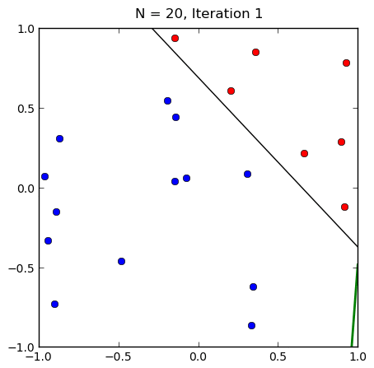
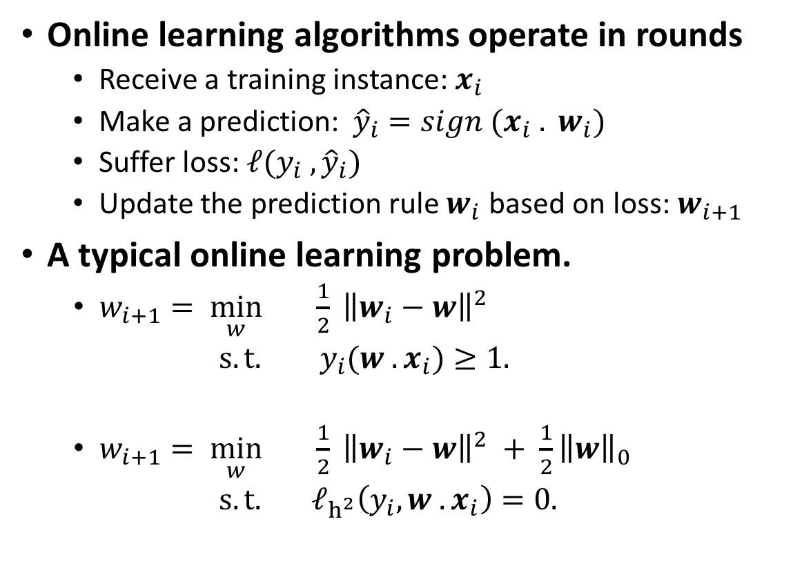
Review: Online Learning of Linear Classifiers
Online learning algorithms operate in rounds
Receive a training instance: $x_{i}$
Make a prediction: ${\hat{y}}_{i}=sign (x_{i} . w_{i})$
Suffer loss: $ℓ(y_{i} , {\hat{y}}_{i})$
Update the prediction rule $w_{i}$ based on loss: $w_{i+1}$
A typical online learning problem.
$w_{i+1}= \min_{w}{ \frac{1}{2} }{\left\|w_{i}−w\right\|}^{2}$
$s.t.$ $y_{i}(w . x_{i})≥1.$
$w_{i+1}= \min_{w}{ \frac{1}{2} }{\left\|w_{i}−w\right\|}^{2} + \frac{1}{2}{\left\|w\right\|}_{0}$
$s.t.$ ${ ℓ}_{h^{2}}\left(y_{i}, w . x_{i}\right)=0.$
Notes:
$y_{i}(x_{i} . w_{i−1})$ is margin and sign of the margin is positive iff classifier predicts correctly.
$\left|y\left(w. x\right)\right|=\left|w.x\right|$ is confidence of the prediction
To give an idea how the problem works, this is a typical online learning problem:
We want to minimize the squared distance between previous classifier and new classifier such that, new classifier would be able to make correct prediction with a fixed margin while keeping learned information from previous instances.
These equations can change form based on the specifics of the problem to be solved.
For example, You can use a loss function instead of a plain … and you can add a regularizer.
This regularizer forces your classifier to be sparse, while use of different loss functions give you different properties.
For example, when hinge loss is used, correctly classified points lying outside the margin boundaries of the support vectors are not penalized, whereas points within the margin boundaries or on the wrong side of the hyperplane are penalized in a linear fashion compared to their distance from the correct boundary.
These decisions depend on how do you want to solve minimization equation (hinge loss is not differentiable, whereas squared hinge is.), and characteristics of your problem.

Slide 9
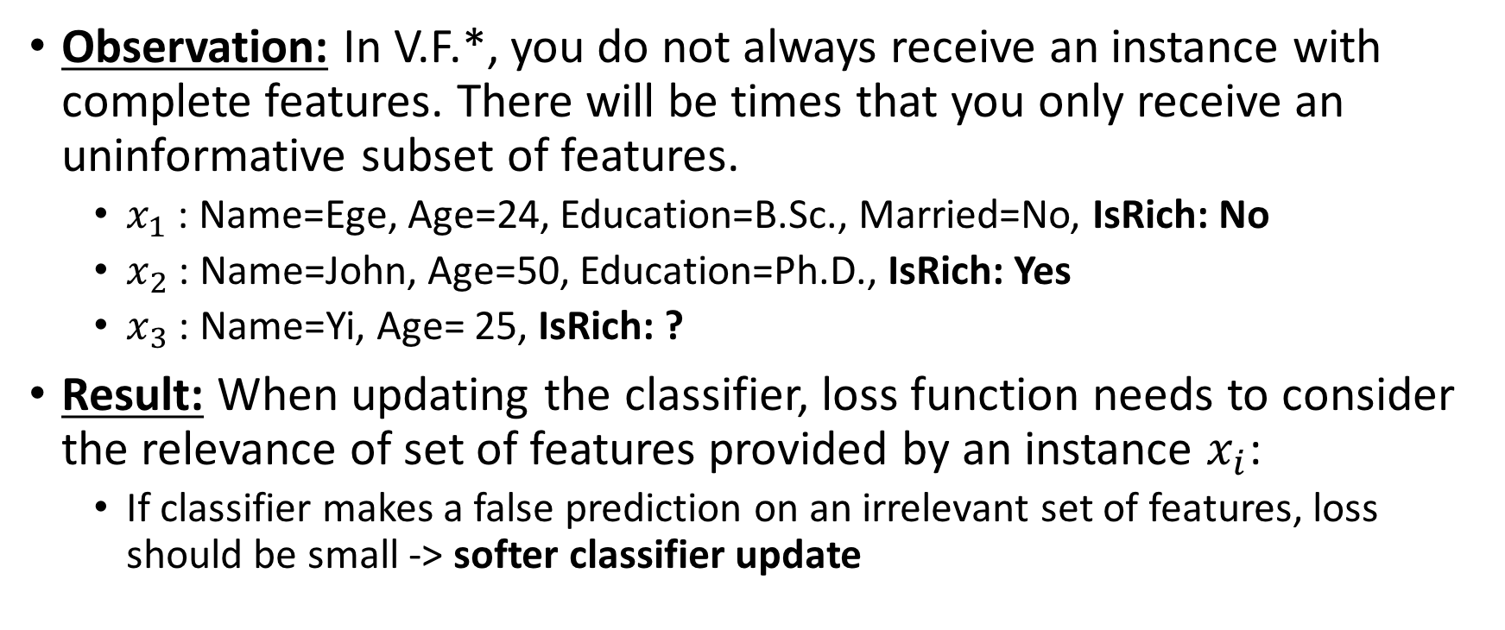
Online Learning from Variable Features: Observation 1
Observation: In V.F.*, you do not always receive an instance with complete features. There will be times that you only receive an uninformative subset of features.
$x_{1}$ : Name=Ege, Age=24, Education=B.Sc., Married=No, IsRich: No
$x_{2}$ : Name=John, Age=50, Education=Ph.D., IsRich: Yes
$x_{3}$ : Name=Yi, Age= 25, IsRich: ?
Result: When updating the classifier, loss function needs to consider the relevance of set of features provided by an instance $x_{i}$:
If classifier makes a false prediction on an irrelevant set of features, loss should be small -> softer classifier update
Notes:
To come up with a technique for online learning from variable features, we first need to identify the key characteristics of our problem.

Slide 10
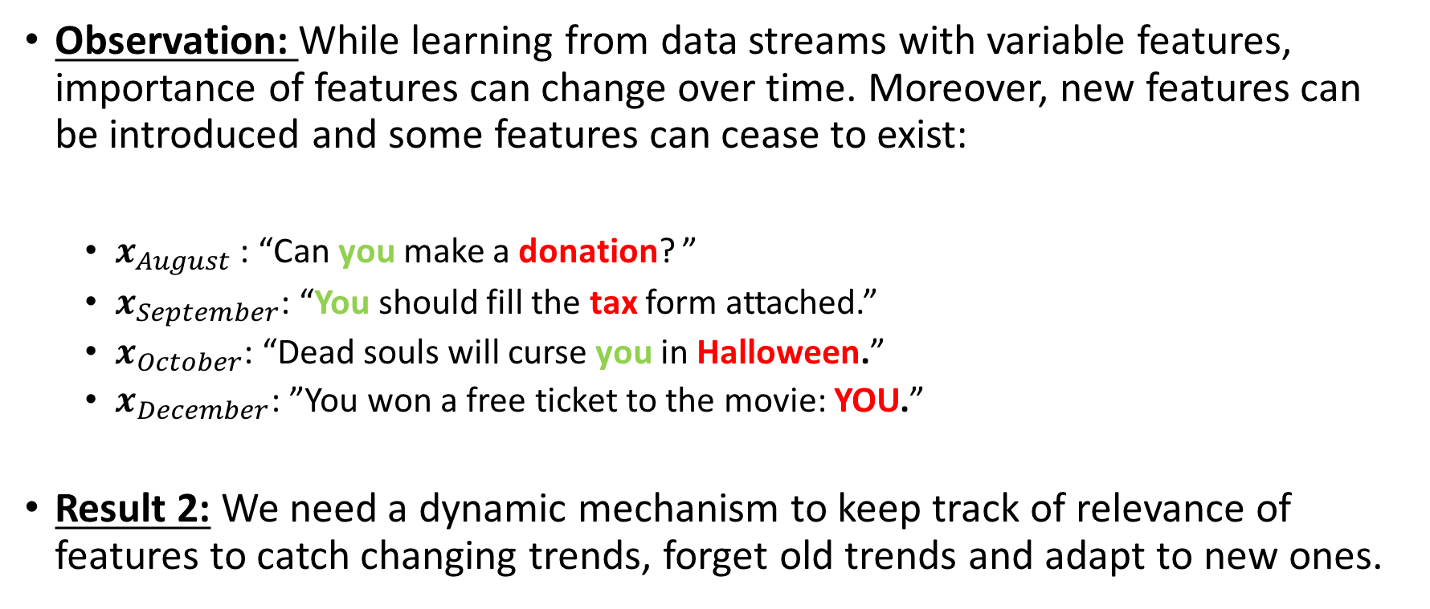
Online Learning from Variable Features: Observation 2
Observation: While learning from data streams with variable features, importance of features can change over time. Moreover, new features can be introduced and some features can cease to exist:
$x_{August}$ : “Can you make a donation? ”
$x_{September}$: “You should fill the tax form attached.”
$x_{October}$: “Dead souls will curse you in Halloween.”
$x_{December}$: ”You won a free ticket to the movie: YOU.”
Result 2: We need a dynamic mechanism to keep track of relevance of features to catch changing trends, forget old trends and adapt to new ones.

Slide 11
Learning the Distribution of Classifier Weights
From observations 1 and 2, we infer that we need a dynamic mechanism to keep track of relevance of features.
In a streaming environment, how to keep track of relevance?
Keep a batch of most recent data
Keep statistics related to past data
Keep statistics of your model
What kind of heuristic can make a good approximation to feature relevance?
Variance of classifier weights

Slide 12
Heuristics
Keep statistics (frequency, mean, variance) of the data as you receive more instances, try probabilistic classification based on statistics,
Instead of learning a classifier, model it as a Normal distribution and learn its parameters,
Formulate the problem as an optimization problem, and try to solve it using gradient descent with adaptive learning rate:
While learning a classifier, also keep track of its variance.
Notes:
To see what is the best way to get this information, I tried a series of ideas.

Slide 13
Variance of a Classifier
Intuition:
Green: [0, 0.9]
Yellow: [0.5, 0,7]
Orange: [-0.4, 1.2]
Red: [0.05, 0.8]
Std (x)= (0.5+0.9+0.35)/3
Std (y)= (0.2+0.5+0.4)/3
Std(x)> Std(y)
Y is more relevant than x.
Notes:
Assume that your data is 2 dimensional, linearly separable just like in the figure.

Slide 14
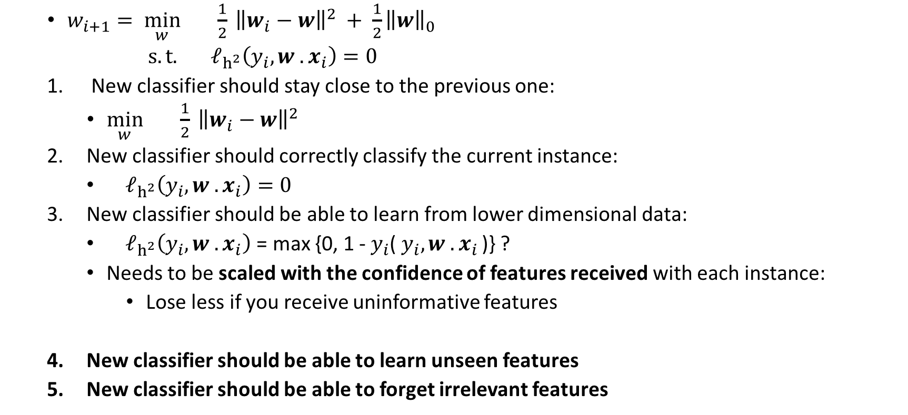
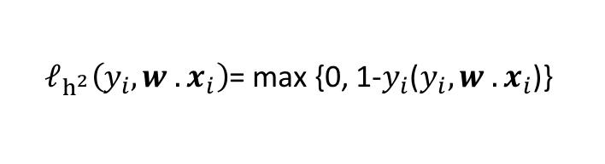
Online Learning from Variable Features
$w_{i+1}= \min_{w}{ \frac{1}{2} }{\left\|w_{i}−w\right\|}^{2} + \frac{1}{2}{\left\|w\right\|}_{0}$
$s.t.$ ${ ℓ}_{h^{2}}\left(y_{i}, w . x_{i}\right)=0$
New classifier should stay close to the previous one:
$\min_{w}{ \frac{1}{2} }{\left\|w_{i}−w\right\|}^{2}$
New classifier should correctly classify the current instance:
${ ℓ}_{h^{2}}\left(y_{i}, w . x_{i}\right)=0$
New classifier should be able to learn from lower dimensional data:
${ ℓ}_{h^{2}}\left(y_{i}, w . x_{i}\right)$ = max {0, 1 -${ y}_{i}$( $y_{i}, w . x_{i }$)} ?
Needs to be scaled with the confidence of features received with each instance:
Lose less if you receive uninformative features
New classifier should be able to learn unseen features
New classifier should be able to forget irrelevant features
${ ℓ}_{h^{2}}\left(y_{i}, w . x_{i}\right)$= max {0, 1-$y_{i}$($y_{i}, w . x_{i}$)}

Slide 15
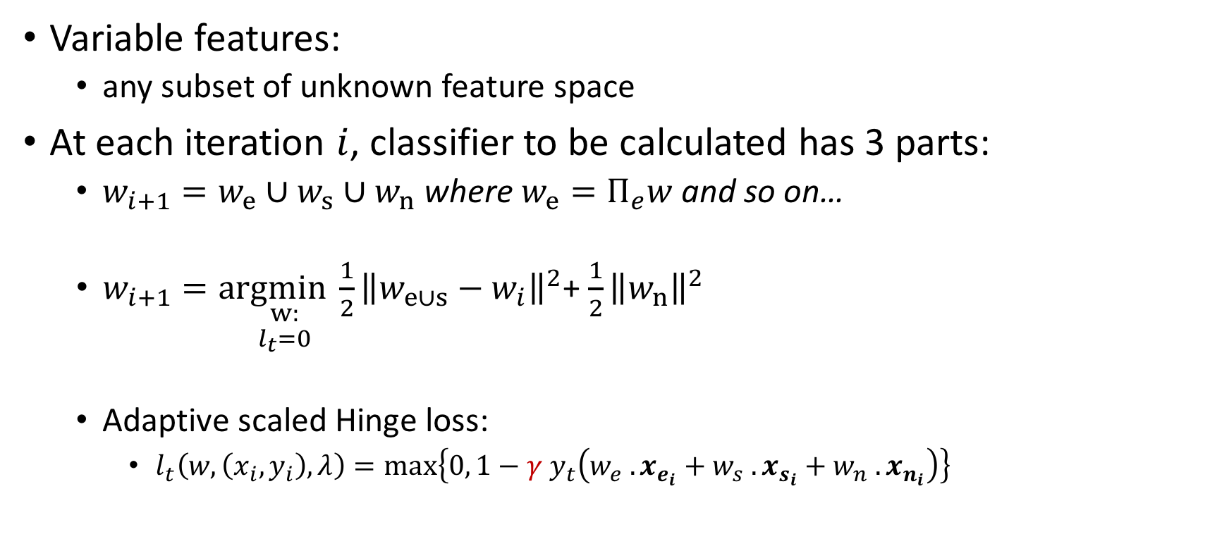
Learn New Features
Classifier
Instance
existing attributes
new attributes
Variable features:
any subset of unknown feature space
At each iteration $i$, classifier to be calculated has 3 parts:
$w_{i+1}=w_{e}∪w_{s}∪w_{n}$ where $w_{e}=Π_{e}w$ and so on…
$w_{i+1}=a\underset{\begin{aligned}w: \\ l_{t}=0\end{aligned}}{rgmin}\frac{1}{2}{\left\|w_{e∪s}−w_{i}\right\|}^{2}$+ $\frac{1}{2}{\left\|w_{n}\right\|}^{2}$
Adaptive scaled Hinge loss:
$l_{t}\left(w, \left(x_{i}, y_{i}\right), λ\right)=max\left\{0, 1−{γ y}_{t}\left(w_{e} . x_{e_{i}}+w_{s} . x_{s_{i}}+w_{n} . x_{n_{i}}\right)\right\}$
Shared attributes
Notes:
W_E is a projection, explain this.
Explain why are you trying to minimize the new part: you are still trying to make minimum change

Slide 16
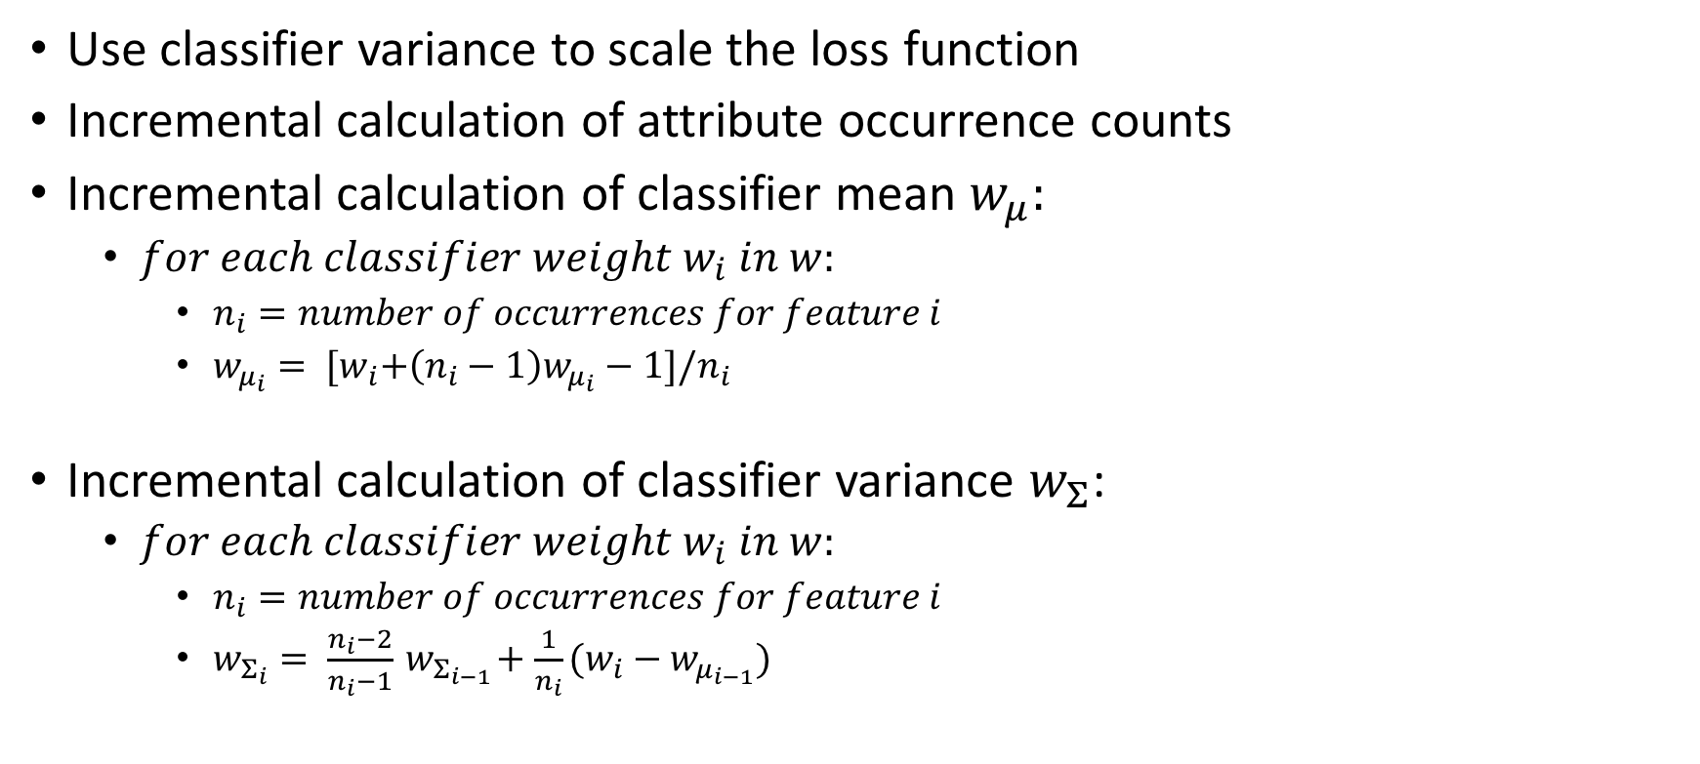
Adaptive Scaled Loss: Mean and Variance
Use classifier variance to scale the loss function
Incremental calculation of attribute occurrence counts
Incremental calculation of classifier mean $w_{μ}:$
$for each classifier weight w_{i} in w:$
$n_{i}=number of occurrences for feature i$
$w_{μ_{i}}= {[w}_{i}+\left(n_{i}−1\right)w_{μ_{i}}−1]/n_{i}$
Incremental calculation of classifier variance $w_{Σ}$:
$for each classifier weight{ w}_{i} in w:$
$n_{i}=number of occurrences for feature i$
$w_{Σ_{i}}= \frac{n_{i}−2}{n_{i}−1}{ w}_{Σ_{i−1}}+\frac{1}{n_{i}}(w_{i}−w_{μ_{i−1}})$

Slide 17
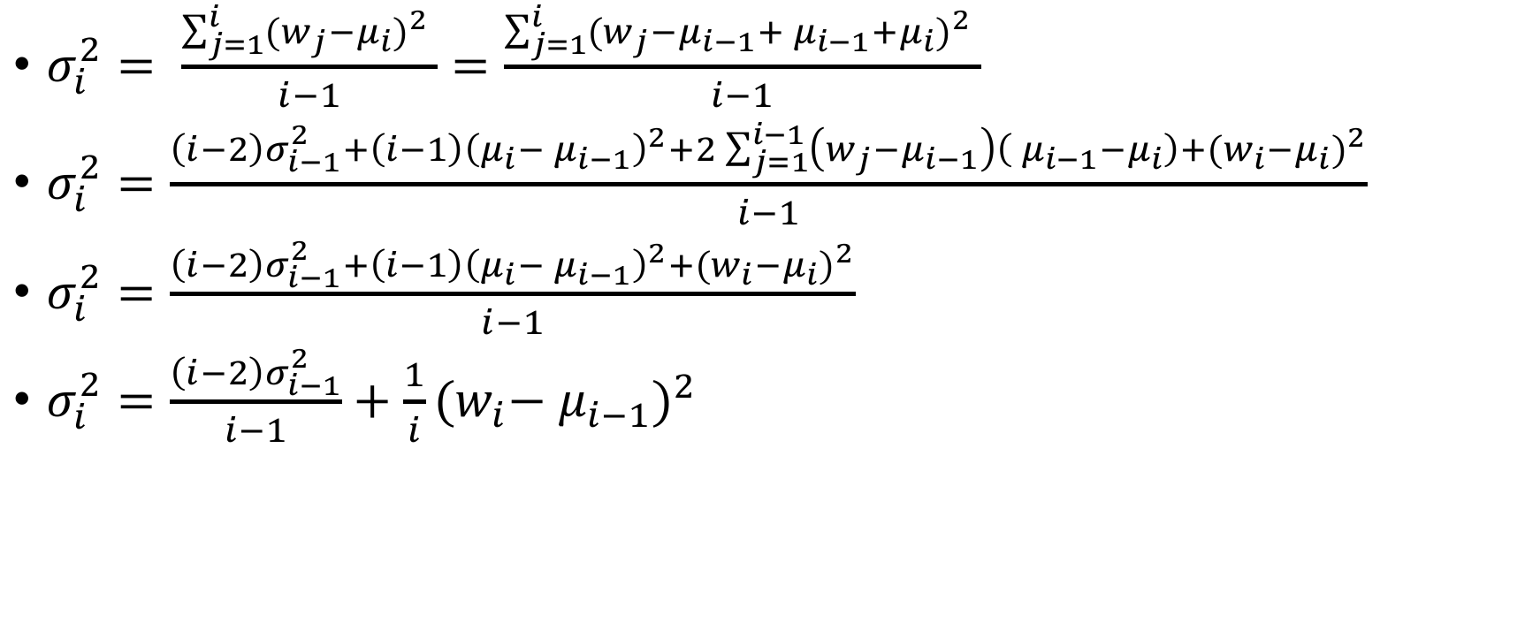
Proof of incremental variance calculation:
$σ_{i}^{2}= \frac{\sum_{j=1}^{i}{{(w_{j}−μ_{i})}^{2} }}{i−1}=\frac{\sum_{j=1}^{i}{{(w_{j}−μ_{i−1}+{ μ}_{i−1}+μ_{i})}^{2} }}{i−1}$
$σ_{i}^{2}=\frac{\left(i−2\right)σ_{i−1}^{2}+\left(i−1\right){\left(μ_{i}−{ μ}_{i−1}\right)}^{2}+2\sum_{j=1}^{i−1}{\left(w_{j}−μ_{i−1}\right)\left({ μ}_{i−1}−μ_{i}\right)+{(w_{i}−μ_{i})}^{2}}}{i−1}$
$σ_{i}^{2}=\frac{\left(i−2\right)σ_{i−1}^{2}+\left(i−1\right){\left(μ_{i}−{ μ}_{i−1}\right)}^{2}+{(w_{i}−μ_{i})}^{2}}{i−1}$
$σ_{i}^{2}=\frac{\left(i−2\right)σ_{i−1}^{2}}{i−1}+\frac{1}{i}{(w_{i}−{ μ}_{i−1})}^{2}$

Slide 18
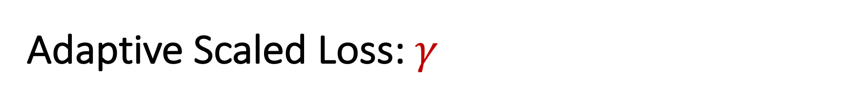
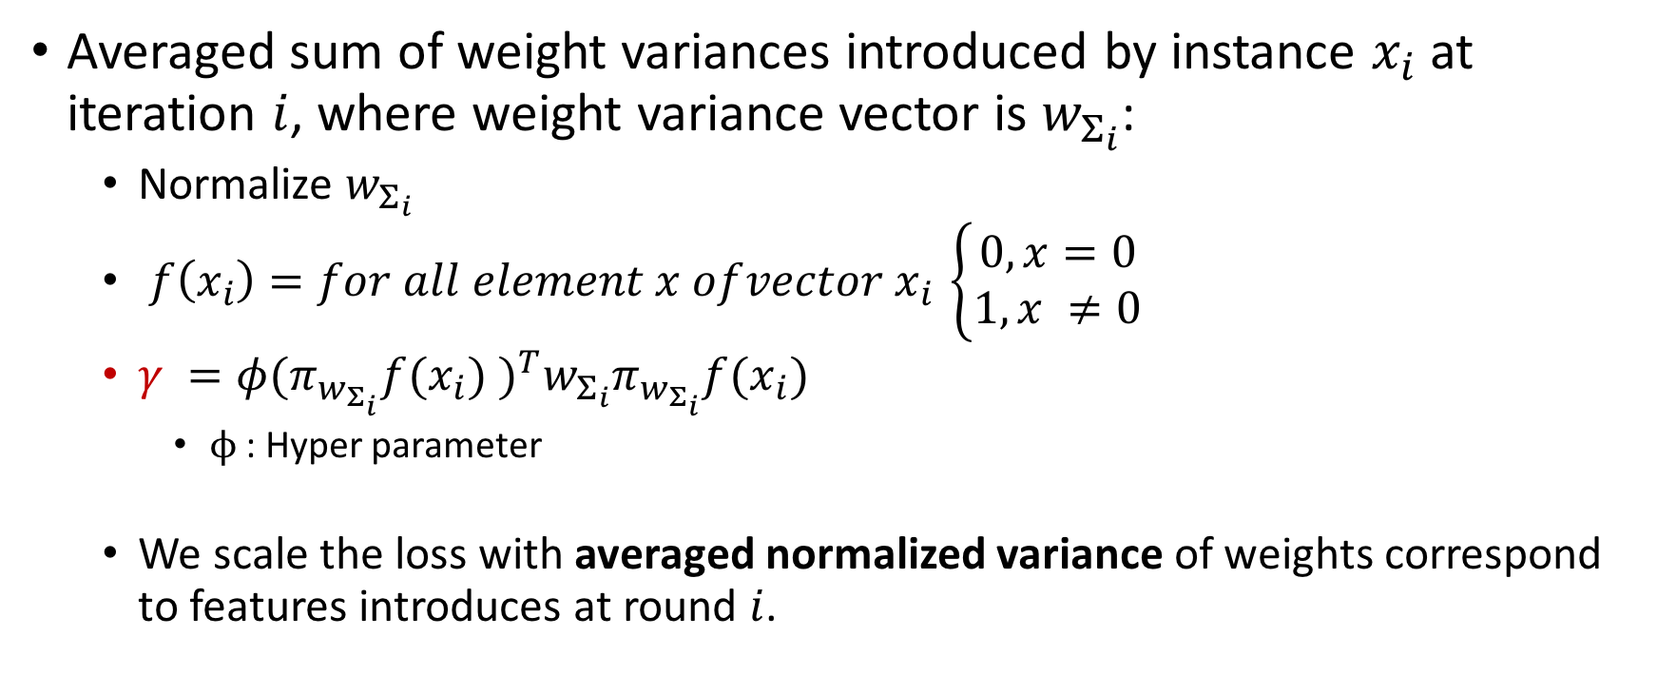
Adaptive Scaled Loss: $γ$
Averaged sum of weight variances introduced by instance $x_{i}$ at iteration $i$, where weight variance vector is $w_{Σ_{i}}$:
Normalize $w_{Σ_{i}}$
$f\left(x_{i}\right)=for all element x of{vector x}_{i }\left\{\begin{aligned}0,x=0 \\ &1,x ≠0\end{aligned}\right.$
$γ ={φ(π_{w_{Σ_{i}}}f(x_{i}) )}^{T}w_{Σ_{i}}π_{w_{Σ_{i}}}f(x_{i})$
$ϕ$ : Hyper parameter
We scale the loss with averaged normalized variance of weights correspond to features introduces at round $i$.

Slide 19
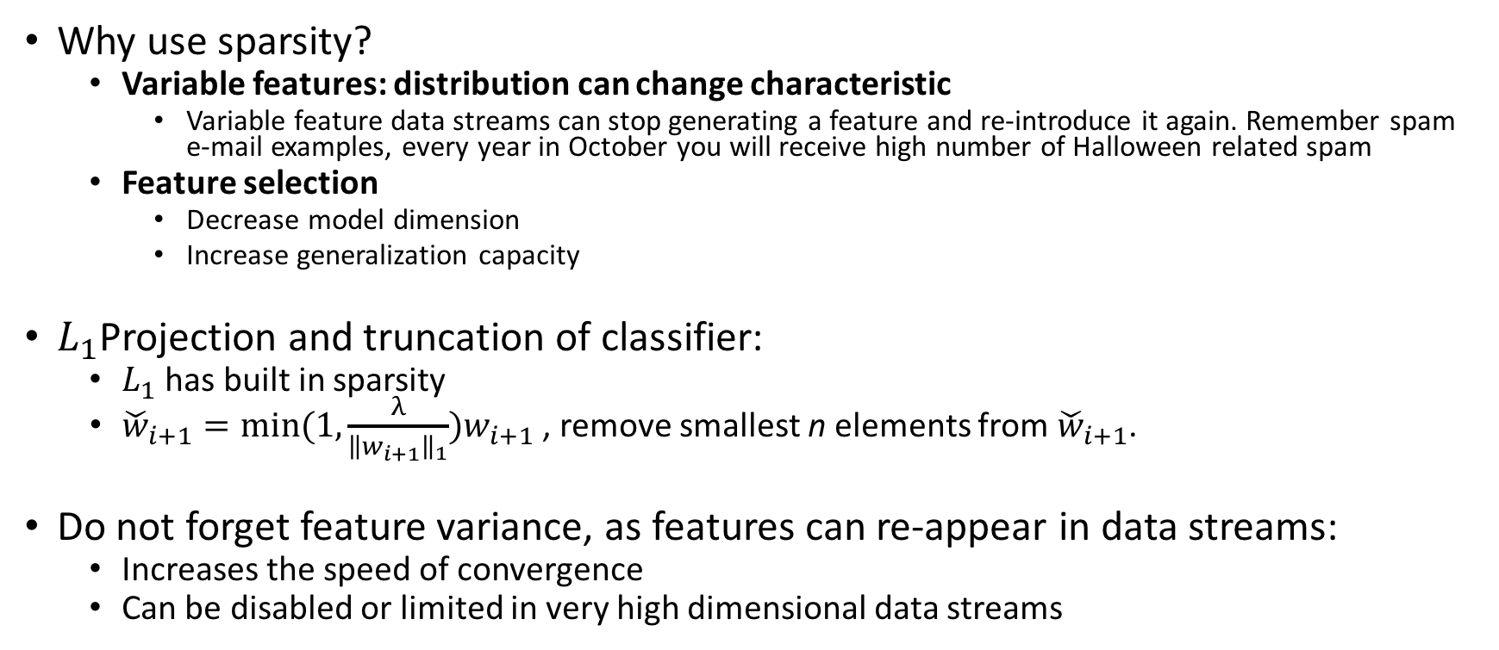
Partial Forgetting: Sparsity
Why use sparsity?
Variable features: distribution can change characteristic
Variable feature data streams can stop generating a feature and re-introduce it again. Remember spam e-mail examples, every year in October you will receive high number of Halloween related spam
Feature selection
Decrease model dimension
Increase generalization capacity
$L_{1}$Projection and truncation of classifier:
$L_{1}$ has built in sparsity
${\check{w}}_{i+1}=min(1,\frac{λ}{{\left\|w_{i+1}\right\|}_{1}})w_{i+1}$ , remove smallest n elements from ${\check{w}}_{i+1}$.
Do not forget feature variance, as features can re-appear in data streams:
Increases the speed of convergence
Can be disabled or limited in very high dimensional data streams

Slide 20
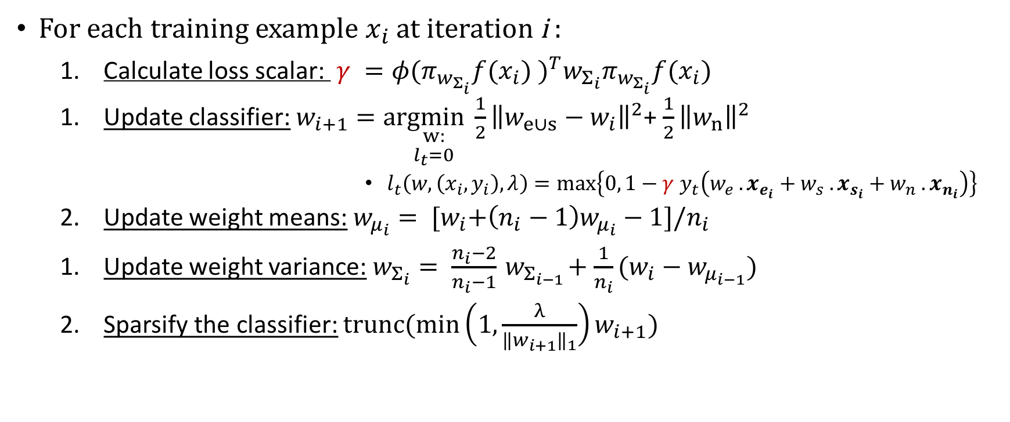
Algorithm: OLVF
For each training example $x_{i}$ at iteration i :
Calculate loss scalar: $γ ={φ(π_{w_{Σ_{i}}}f(x_{i}) )}^{T}w_{Σ_{i}}π_{w_{Σ_{i}}}f(x_{i})$
Update classifier: $w_{i+1}=a\underset{\begin{aligned}w: \\ l_{t}=0\end{aligned}}{rgmin}\frac{1}{2}{\left\|w_{e∪s}−w_{i}\right\|}^{2}$+ $\frac{1}{2}{\left\|w_{n}\right\|}^{2}$
$l_{t}\left(w, \left(x_{i}, y_{i}\right), λ\right)=max\left\{0, 1−{γ y}_{t}\left(w_{e} . x_{e_{i}}+w_{s} . x_{s_{i}}+w_{n} . x_{n_{i}}\right)\right\}$
Update weight means: $w_{μ_{i}}= {[w}_{i}+\left(n_{i}−1\right)w_{μ_{i}}−1]/n_{i}$
Update weight variance: $w_{Σ_{i}}= \frac{n_{i}−2}{n_{i}−1}{ w}_{Σ_{i−1}}+\frac{1}{n_{i}}(w_{i}−w_{μ_{i−1}})$
Sparsify the classifier: $trunc(min\left(1,\frac{λ}{{\left\|w_{i+1}\right\|}_{1}}\right)w_{i+1})$

Slide 21
Experiments: Dataset Statistics
 | a8a | german | ionosphere | magic04 | spambase | svmguide3 | wdbc | wpbc | Enron | TREC | URL
Instances | 22,696 | 1,000 | 351 | 19,029 | 4,601 | 1,243 | 569 | 198 | 500,000 e-mails | 30,000 e-mails | 2,396,130
Features | 123 | 25 | 34 | 11 | 57 | 21 | 32 | 34 | - | - | 3,231,961
Source | UCI | UCI | UCI | UCI | UCI | UCI | UCI | UCI | CMU | NIST | UCI
Missing | - | - | no | no | yes | - | no | yes | - | - | -
More | - | - | - | - | - | - | - | - | Time series | - | Time series

Slide 22
Experiments
2 of algorithms I developed worked:
Adaptive Confidence Weighted Learning from Variable Features
UCI datasets
Enron Spam e-mail dataset
TREC dataset
Online Learning from Variable Features (adaptive scaled lost)
UCI datasets
Trapezoidal scenario
Variable features scenario
In progress: TREC, Enron, URL

Slide 23
Adaptive Confidence Weighted Learning from Variable Features
Slow convergence
Bad accuracy on (small) UCI datasets
Good accuracy on (big and high dimensional) TREC and ENRON datasets
Sensitive to noise
Performs good in real life variable features but bad in simulated variable features (random removal of data)
Non-sparse classifiers
Can not learn sparse classifiers, classifier dimension gets huge in high dimensional datasets

Slide 24
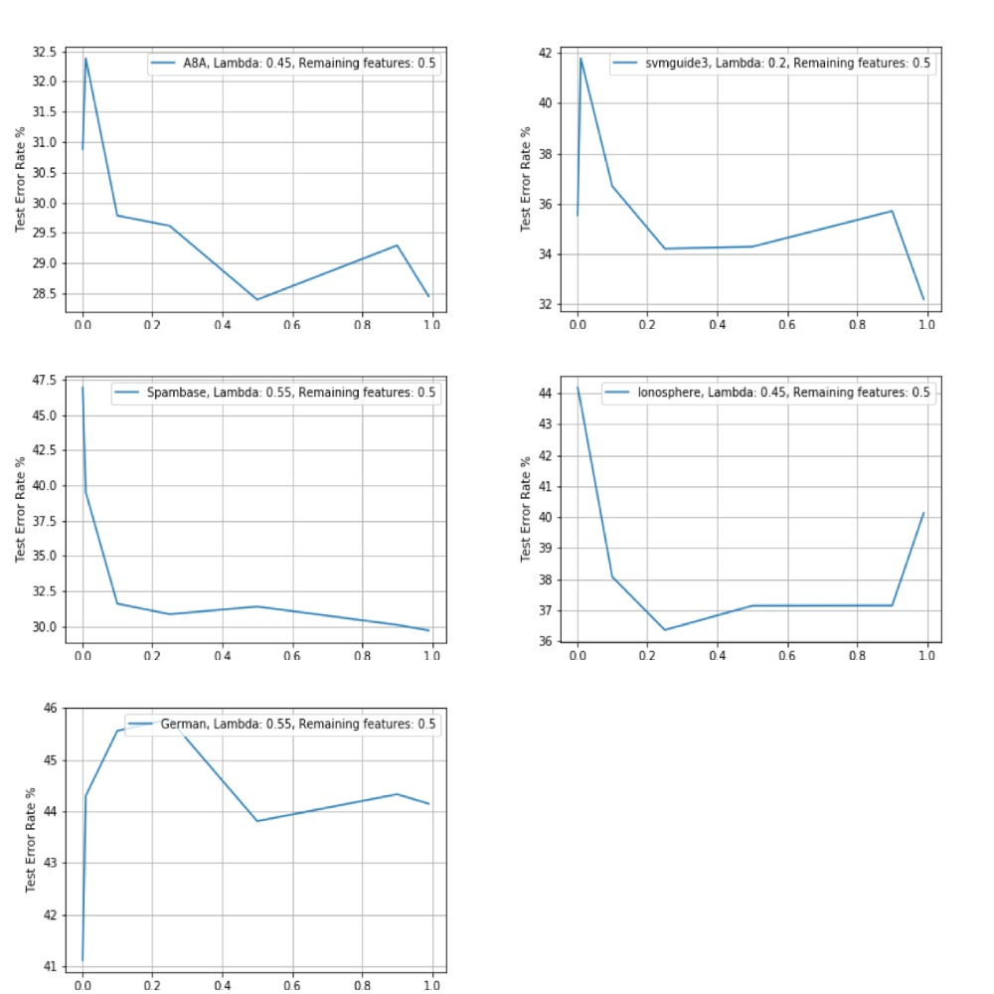
UCI Experiments

Slide 25
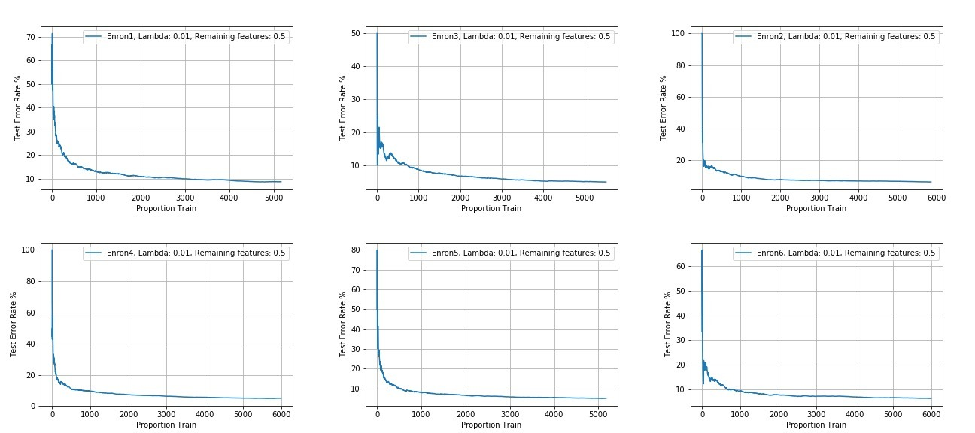
Enron Experiments

Slide 26
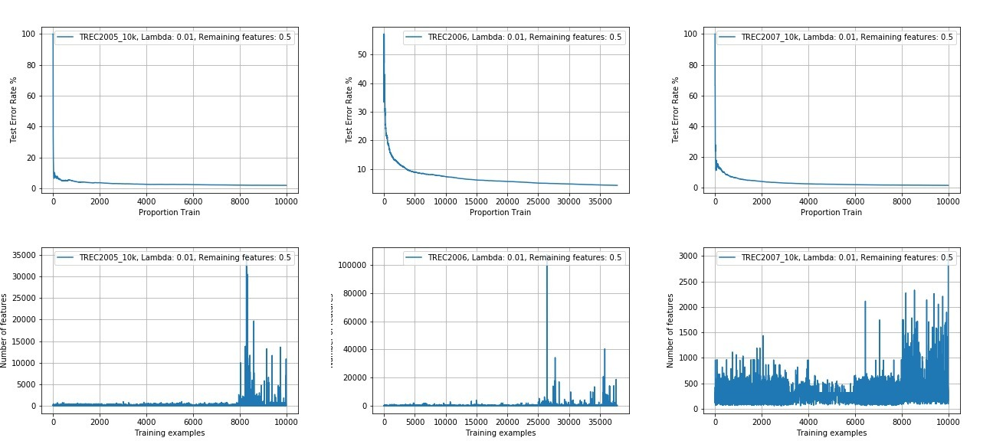
TREC Experiments

Slide 27
Online Learning from Variable Features
Trapezoidal Feature Streams
Higher prediction than state of the art OLSF variants
Variable Feature Streams
Higher prediction accuracy than traditional online learners
They are not designed for this
Algorithms do not converge
Higher prediction accuracy than OLSF variants in variable feature scenario
OLSF is not proper for variable features
Close prediction accuracy to OLSF variants in trapezoidal features
Real Life Variable Features
In progress

Slide 28
Online Learning from Trapezoidal Data Streams: OLSF Algorithms

Slide 29
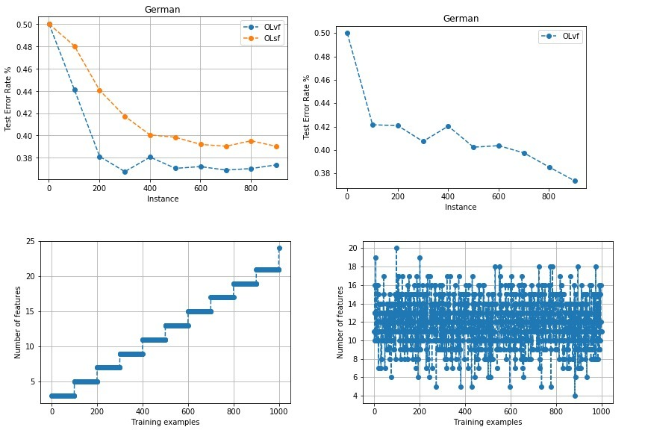
OLVF: UCI German

Slide 30
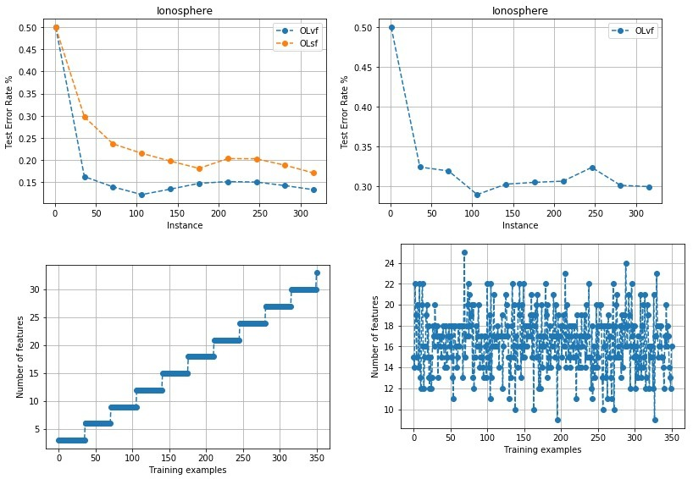
OLVF: UCI Ionosphere

Slide 31
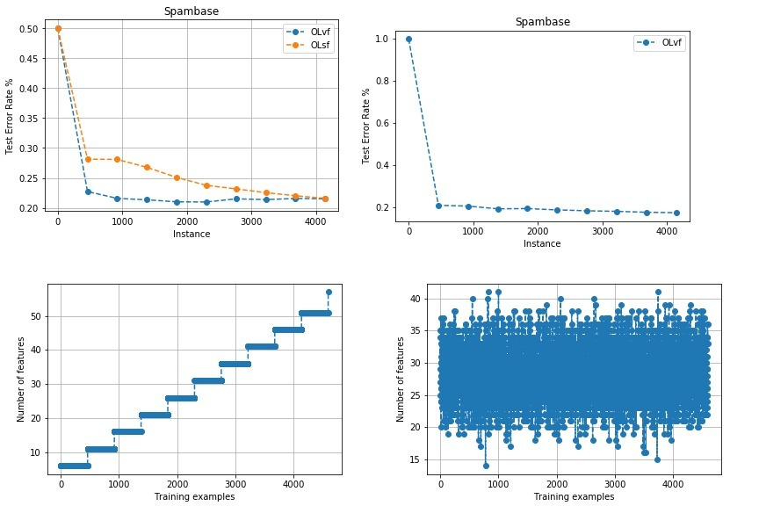
OLVF: UCI Spambase

Slide 32
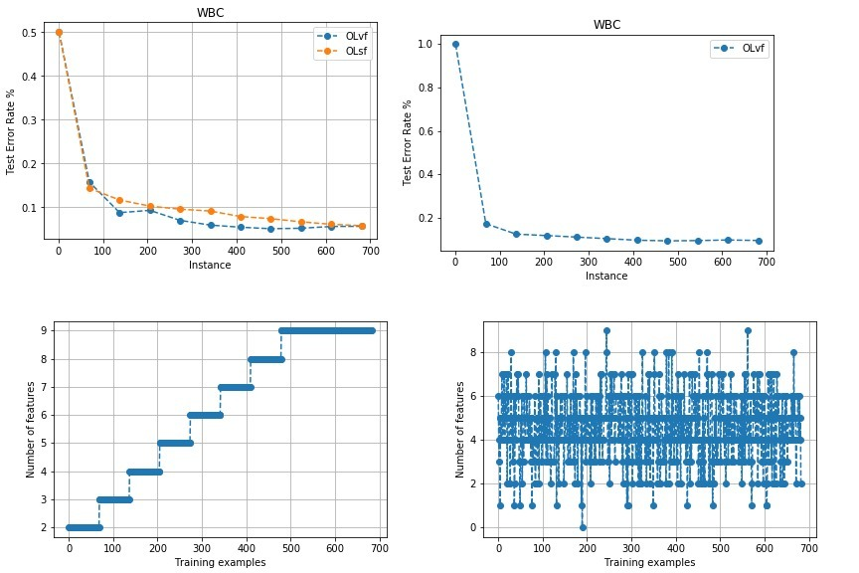
OLFV: WBC

Slide 33
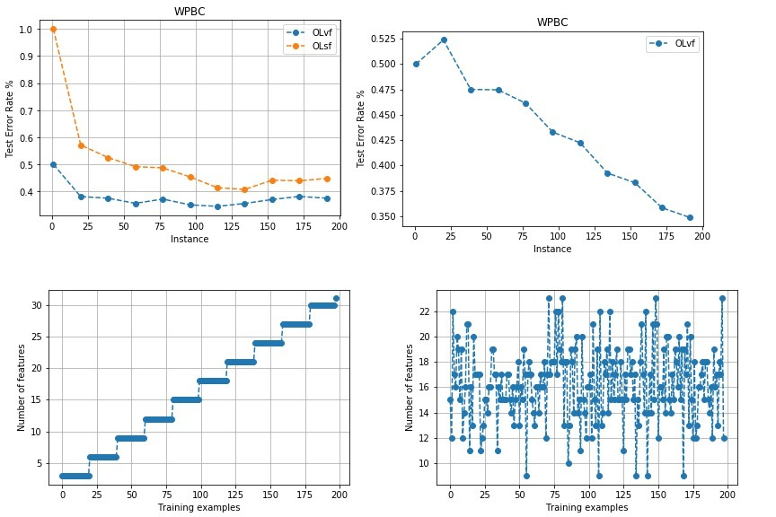
OLVF: WPBC

Slide 34
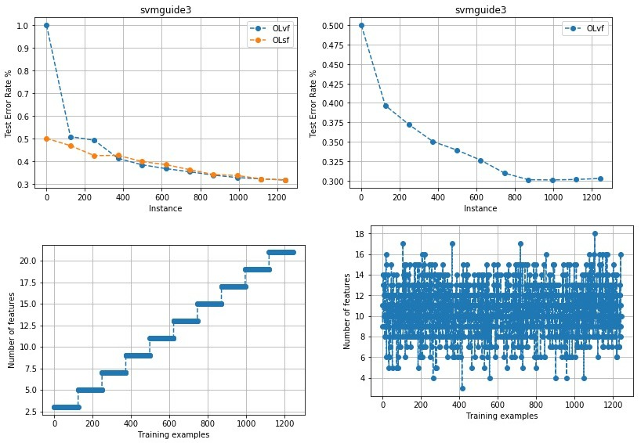
OLVF: svmguide3

